Slide 1
INTRODUCTION OF YOGA
MODULE 1

Slide 2
Etymology of yoga
Concept of chitta and chitta bhumis
General introduction to four paths of yoga
Importance of nadi and chakra in yoga

Slide 3
Etymology of yoga
Yoga means union
Etymologically it has been derived from Sanskrit word “yuj” meaning to bind, join, attach
It signifies union with supreme universal spirit to obtain relief from pain and suffering
Ultimate goal of yoga is union of jivatma with parmatma
Patanjali’s yoga sutra defines yoga as ‘chitta vritti nirodhah’ (complete control of mental modifications.

Slide 4
Concept of chitta and chitta bhumis
The word chitta denotes mind in totality as being composed of (manas) mind, (buddhi) intellect, and (ahamkara) ego.
It is the finest form of matter
Chittavritti are mental modifications in the form of thoughts, waves, fluctuations, operations or activities of the chitta which create disturbance in mind
Yoga is a method by which these chittavritti are controlled and restless mind is calmed.

Slide 5
Chittabhumi means different stages of chitta during sadhaka’s lifetime.
Sage vyasa described these under 5 categories depending upon the domination of chitta by rajas, tamas and sattva gunas.
5 states of chitta bhumis:
Kshipta
Mudha
Vikshipta
Ekagra
Niruddha

Slide 6
Moodha: the moodha chitta is forgetful, blinded and possessed of the sleep modification. This chitta posseses the least concentration.
Kshipta: the kshipta chitta is restless and roving
Vikshipta: vikshipta chitta is one that oscillates between the opposites.
Ekagra: ekagra chitta is one pointed, focused or concentrated.
Niruddha: completely (restrained) free from any sort of thoughts good or bad, no mind stage.

Slide 7
Four paths of yoga
Karma yoga (path of action)
Jnana yoga (path of knowledge)
Raja yoga (path of psychic control)
Bhakti yoga (path of devotion and worship)

Slide 8
Karma yoga
Karma yog exhorts the person to perform the work to the best of his/her abilities without any attachment / expectation to the results.
In karma yoga frame of mind with which actions are done is important
Karma as duty
Karmasu kaushalam (skillfulness in actions)
Nishkama karma (abandonment of expectations for the results)
Samatva (equanimity)
Egolessness

Slide 9
Jnana yoga
Related to knowledge of self, world and realization of ultimate reality
Jnana means knowledge and wisdom
Keeps a person away from avidya (ignorance) – root cause of all sorrows
It’s a means to awaken the faculty of intellect
Its reflective and contemplative in nature
Its roots can be traced in vedas and Upanishads.
It’s a process of learning to discriminate between real and unreal, between eternal and that’s what is not.

Slide 10
Raja yoga
It’s a systematic way to culture the mind
Aimed at developing dormant potential of personality
The power of attention of mind when properly guided and directed towards internal world will help to analyse the mind and illuminate the facts.
Raj yoga discusses kriya yoga as a way to control vrittis.
It consists of tapas, swadhyaya and ishwarapranidhana.
Abhyas and vairagya are also emphasized in raj yoga to control chittavrittis.
Raj yoga is based on ashtanga yoga (eight limbed yoga)

Slide 11
In order to eliminate vrittis, patanjali proposed ashtanga yoga which harnesses the will.
Ashtanga yoga works on all 5 koshas (sheaths) of the person – yama, niyama, asana, pranayama, pratyahara, dharana, dhyana, Samadhi.
Yama- ahimsa, satya, asteya, brahmcharya, aparigraha
Niyama- shauch, Santosh, swadhyaya, tapas, ishwarpranidhana
Pratyahara- withdrawl of senses from their external objects. It increases will power and control on the senses.

Slide 12
Bhakti yoga
Personal god
Liberation (moksha)
Divine grace (anugraha)
Dualism

Slide 13
Importance of nadi and chakra in yoga
Nadis are subtle channels in the body through which prana (life force) flows.
According to some manuals the number of nadis is 72,000 (others mention 350,000).
Fourteen are more important than the others, but the most important among these are six: ida, pingala, sushumna, brahmani, chitrani, and vijnani.
Among these six, three are the most important: pingala (surya), which flows through the right nostril; ida (chandra), which flows through the left nostril; and sushumna, which is a moment when both nostrils flow freely without any obstruction.

Slide 14
For meditation, the application of sushumna is of prime importance.
These three major nadis originate at the base of the spine and travel upward.
The sushumna nadi is centrally located and travels along the spinal canal. At the level of the larynx it divides into an anterior and a posterior portion, both of which terminate in the brahmarandhra (cavity of Brahma), which corresponds to the ventricular cavities in the brain.
The ida and pingala nadis also travel upward along the spinal column, but they crisscross each other and the sushumna before terminating in the left and right nostrils, respectively.

Slide 15
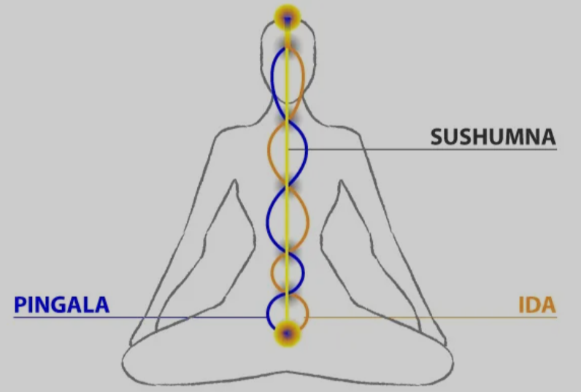

Slide 16
The junctions where the ida, pingala, and sushumna nadis meet along the spinal column are called chakras (wheels).
There are seven principal chakras: the muladhara chakra, at the base of the spine at the level of the inferior hypogastric plexus in the physical body;
the svadhishthana chakra, at the level of the superior hypogastric plexus;
the manipura chakra, at the level of the solar (celiac) plexus;

Slide 17
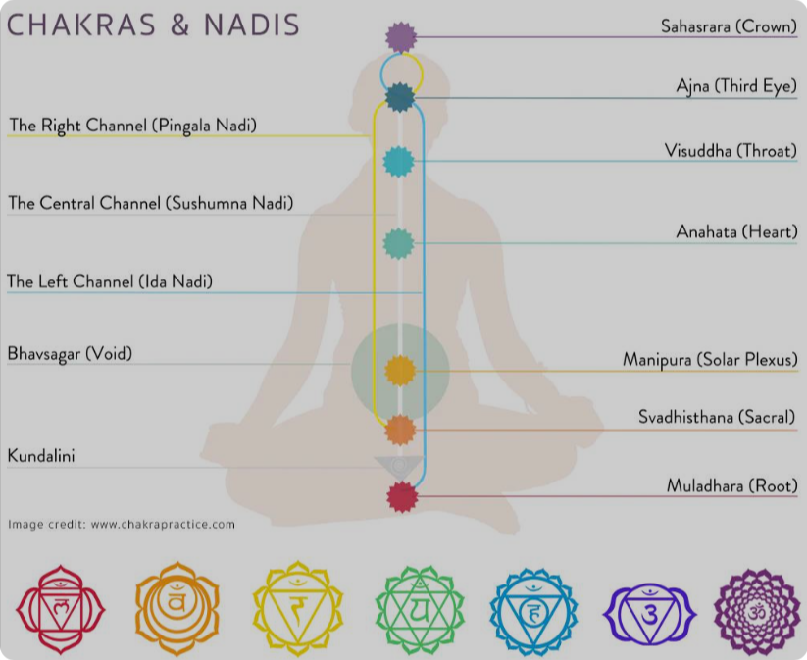

Slide 18
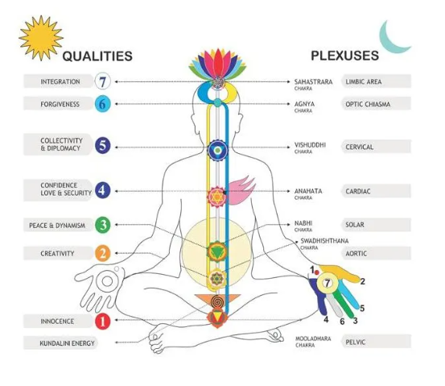

Slide 19
the anahata chakra, at the level of the cardiac plexus;
the vishuddha chakra, at the level of the pharyngeal plexus;
the ajna chakra, at the level of the nasociliary plexus; and
the sahasrara chakra, at the top of the head.
The anterior portion of the sushumna passes through the ajna chakra, and the posterior portion passes behind the skull, the two portions uniting in the brahmarandhra.
descriptions of nadis and chakras bear a remarkable resemblance to modern anatomical descriptions of nerves and plexuses, respectively

Slide 20
nadis and chakras belong to what is known in yoga science as the sukshma sharira (subtle body)
These networks were discovered by mapping the flow of prana.
they developed this mapping ability through introspective experimentation.
The way different nerves, arteries, veins work on the gross body to transmit the nerve impulses, blood, and other nutrients throughout the whole body. Likewise, nadis and chakras are the transmission medium that works in the subtle body to carry and spread prana, consciousness.

Slide 21
However, because nadis and chakras actually are the components of Pranamaya kosha, a layer that is found in the subtle body, they cannot be seen by the naked eyes.
One can only sense the presence of it in deep meditation as these are present in pranamaya kosha.
Pranamaya kosha is one of 5 koshas (sheath) that comes after a yogi successfully passed Annamaya kosha – the physical “food sheath”.

Slide 22
Chakras are powerful centers in our subtle body. Any “change” that we observe in our physical body always has a “cause” that lies in our chakras system.
It’s like a cause and effect relationship. The effect is observed in the gross body, while the cause usually manifests in the subtle body.
To make the chakra harmoniously function, Nadis are something you can work on.
To Pranayama is like physical exercise which purify nadis and work on Nadis, keeps Prana flow controlled in it

